Slide 1

This PPT
Simple Multigraph Convolution Networks
Xinjie Shen
South China University of Technology

Slide 2
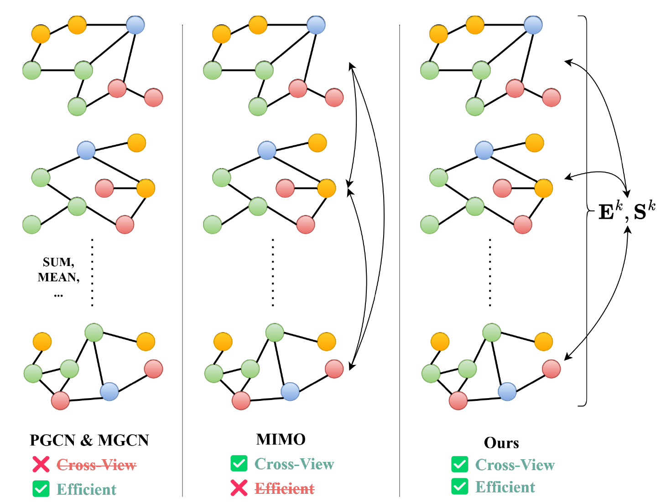
Simple Multigraph Convolution Networks
Existing multigraph convolution methods still have difficult in effectively solving the conflict between effectiveness and efficiency
Notes:
Simulate p(x)；transform noise distribution to p(x)

Slide 3
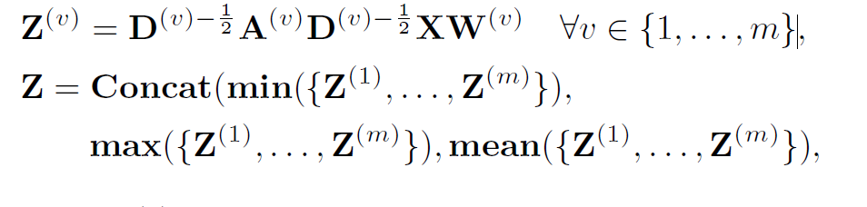
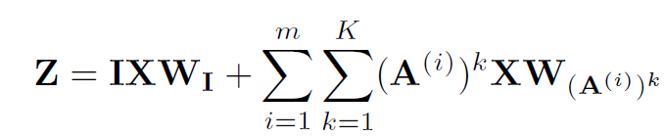
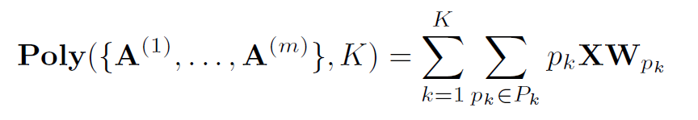
Simple Multigraph Convolution Networks
Previous methods
PGCN
MGCN
MIMO-GCN
Notes:
Simulate p(x)；transform noise distribution to p(x)

Slide 4
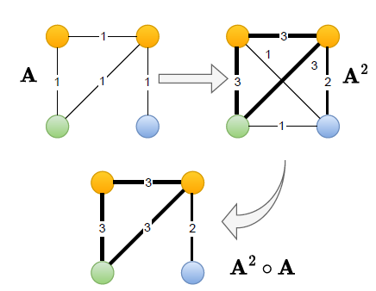
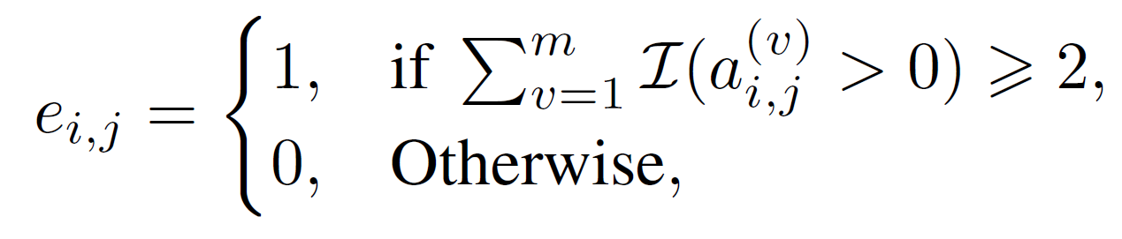
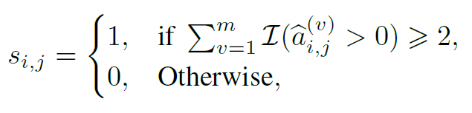
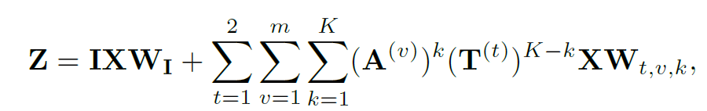
Simple Multigraph Convolution Networks
Build Credible Graph
Edge-level
Subgraph-level
Edge voting from multigraph
Notes:
Simulate p(x)；transform noise distribution to p(x)

Slide 5
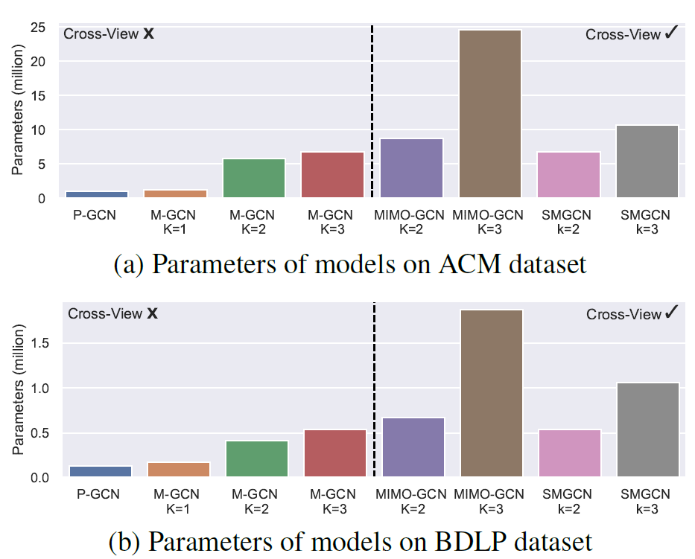
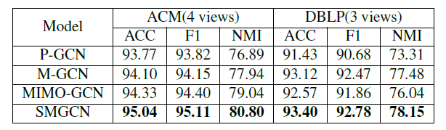
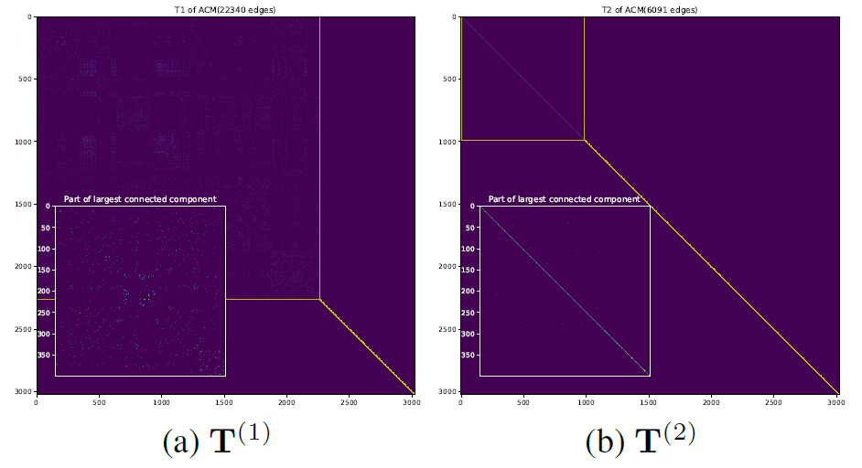
SMGCN
Experiments
Notes:
Simulate p(x)；transform noise distribution to p(x)

Slide 6

Thank You
Here are our codes
https://github.com/frinkleko/SMGCN
Notes:
Simulate p(x)；transform noise distribution to p(x)

