Slide 1


Idea King
Understand, propose, and evolve

Slide 2

Roadmap
Let LLM learn to measure and propose ideas
💡
🧐
😀
Dataset
Critic
King
Ideas-Ratings
Dataset
Measuring Ideas
Propose Ideas

Slide 3
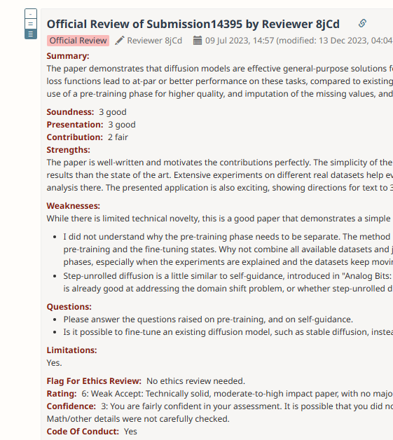
Dataset
OpenReview Dataset
N*M*{
  Soundness,
  Presentation,
  Contribution,
  Rating,
  Confidence,
  TextReviews,
  ….} + papers
Peer tells,
LLM learns

Slide 4
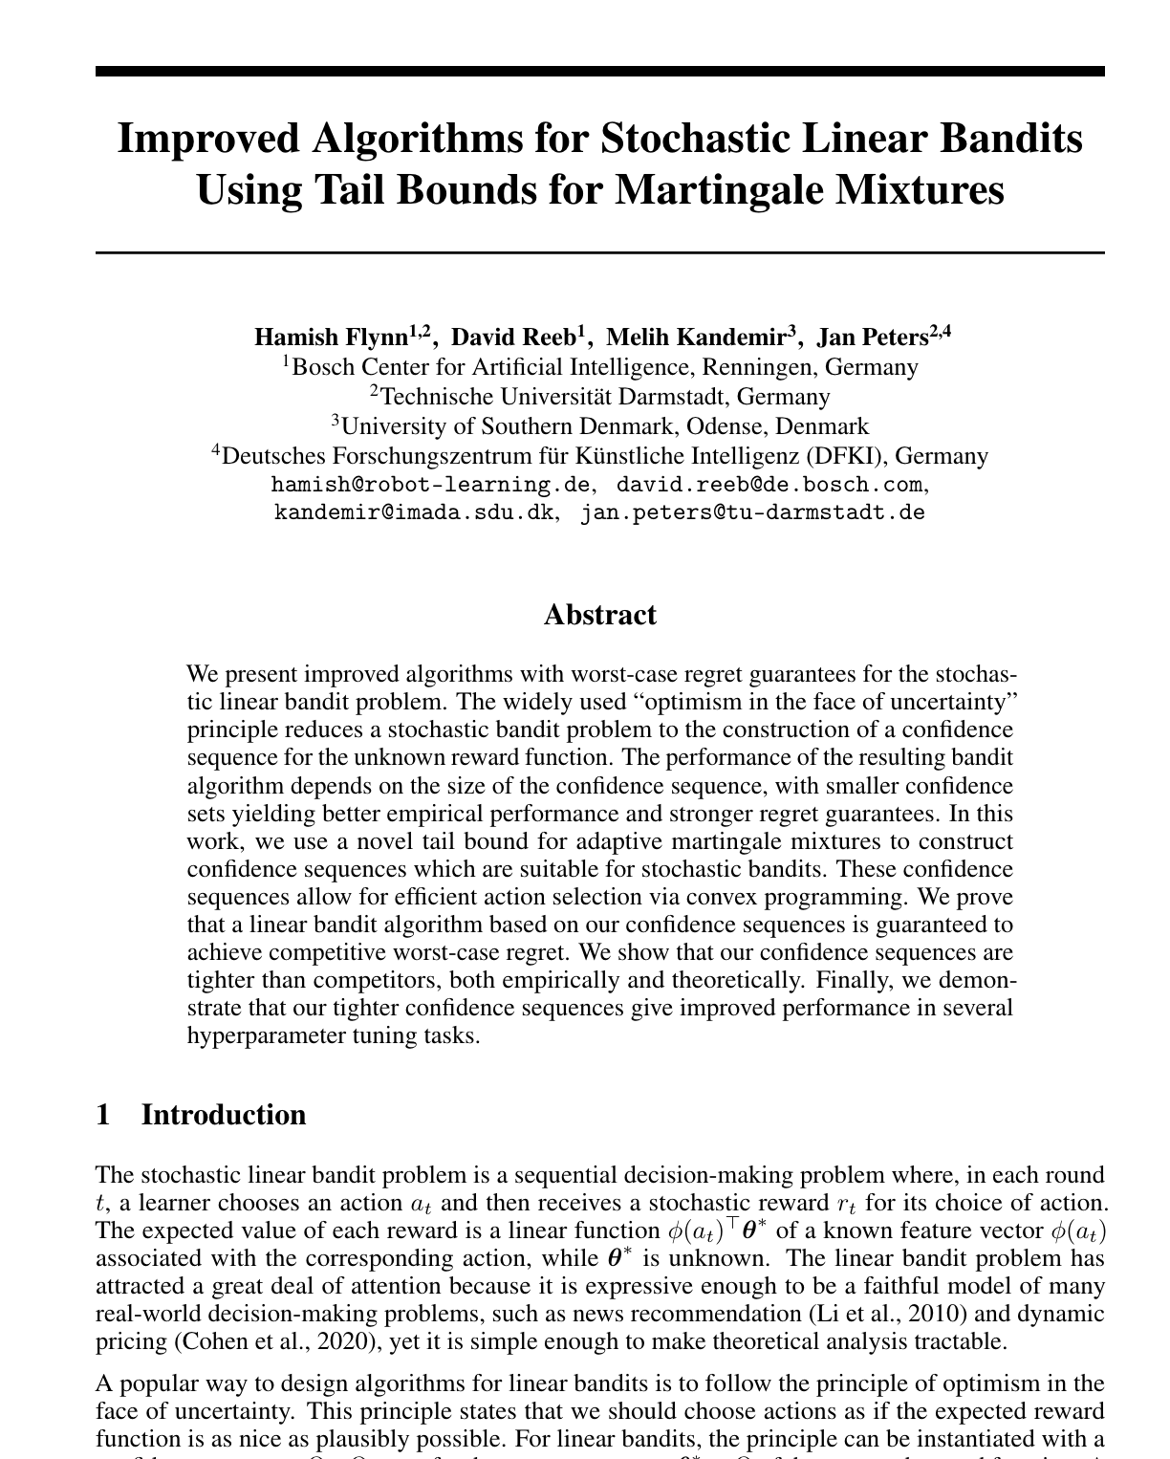
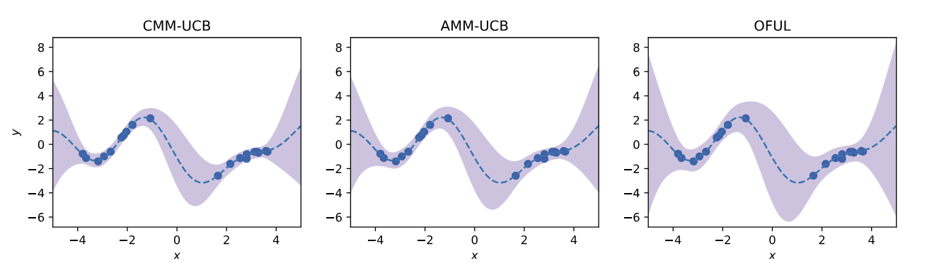
Dataset
{
"text":
Improved Algorithms for Stochastic Linear Bandits Using Tail Bounds for Martingale Mixtures
Hamish Flynn!,2, David Reeb', Melih Kandemir, Jan Peters?,4 'Bosch Center for Artificial Intelligence, Renningen, Germany 2 Technische Universität Darmstadt, Germany 3 University of Southern Denmark, Odense, Denmark 4Deutsches Forschungszentrum für Künstliche Intelligenz (DFKI), Germany hamish@robot-learning.de, david.reeb@de.bosch.com, kandemir@imada.sdu.dk, jan.peters@tu-darmstadt.de
Abstract
We present improved algorithms with worst-case regret guarantees for the stochastic linear bandit problem. The widely used "optimism in the face …...
PDF to text
and
Images with caption
in JSON
GROBID
"image":
Figure 1: Tighter upper and lower confidence bounds via tail bounds for martingale mixtures. The upper and lower confidence bounds of CMM-UCB (left), AMM-UCB (middle), and OFUL (Abbasi-Yadkori et al., 2011) (right) for a test function linear in random Fourier features. The bounds from CMM-UCB and AMM-UCB are visibly closer to the true function (dashed line) than those of OFUL. The CMM-UCB confidence bounds are slightly tighter than the ones of AMM-UCB.
}

Slide 5
Dataset
Including:
NIPS 2021-2023
CVPR 2021-2023
ICLR 2020-2023
with
Abstract
PDF and Transcription
Figures
Reviews
OpenReview Dataset
Multi-model Dataset with
100K+ Papers
300K+ Images&Charts
2000K+ Reviews

Slide 6

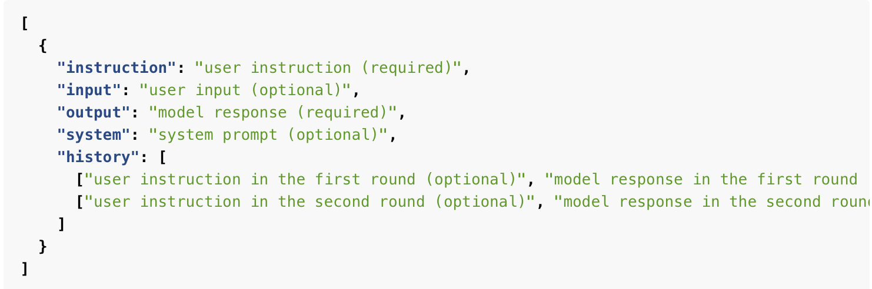
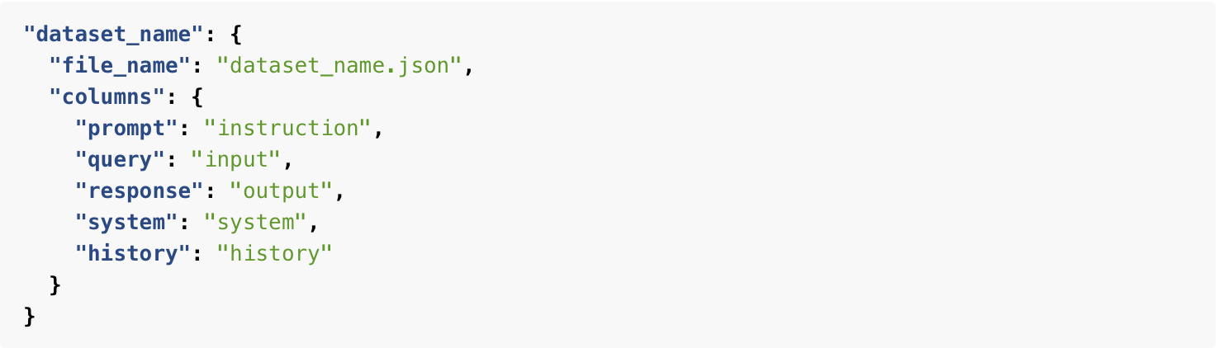
Dataset
Alpaca-format &Opensource
https://github.com/frinkleko/Apache-Conferences-Dataset

Slide 7

Idea Critic
Peer tells, LLM learns by
OpenReview Dataset
🧐
LLM
Extractor/
Summarizer
Scores
(Multi-task loss)
(Azure Intelligence, …)
(Llama3,...)
Finetune for Text-Score regression

Slide 8
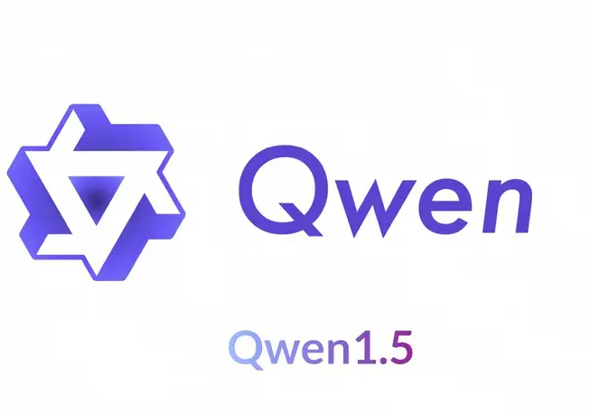
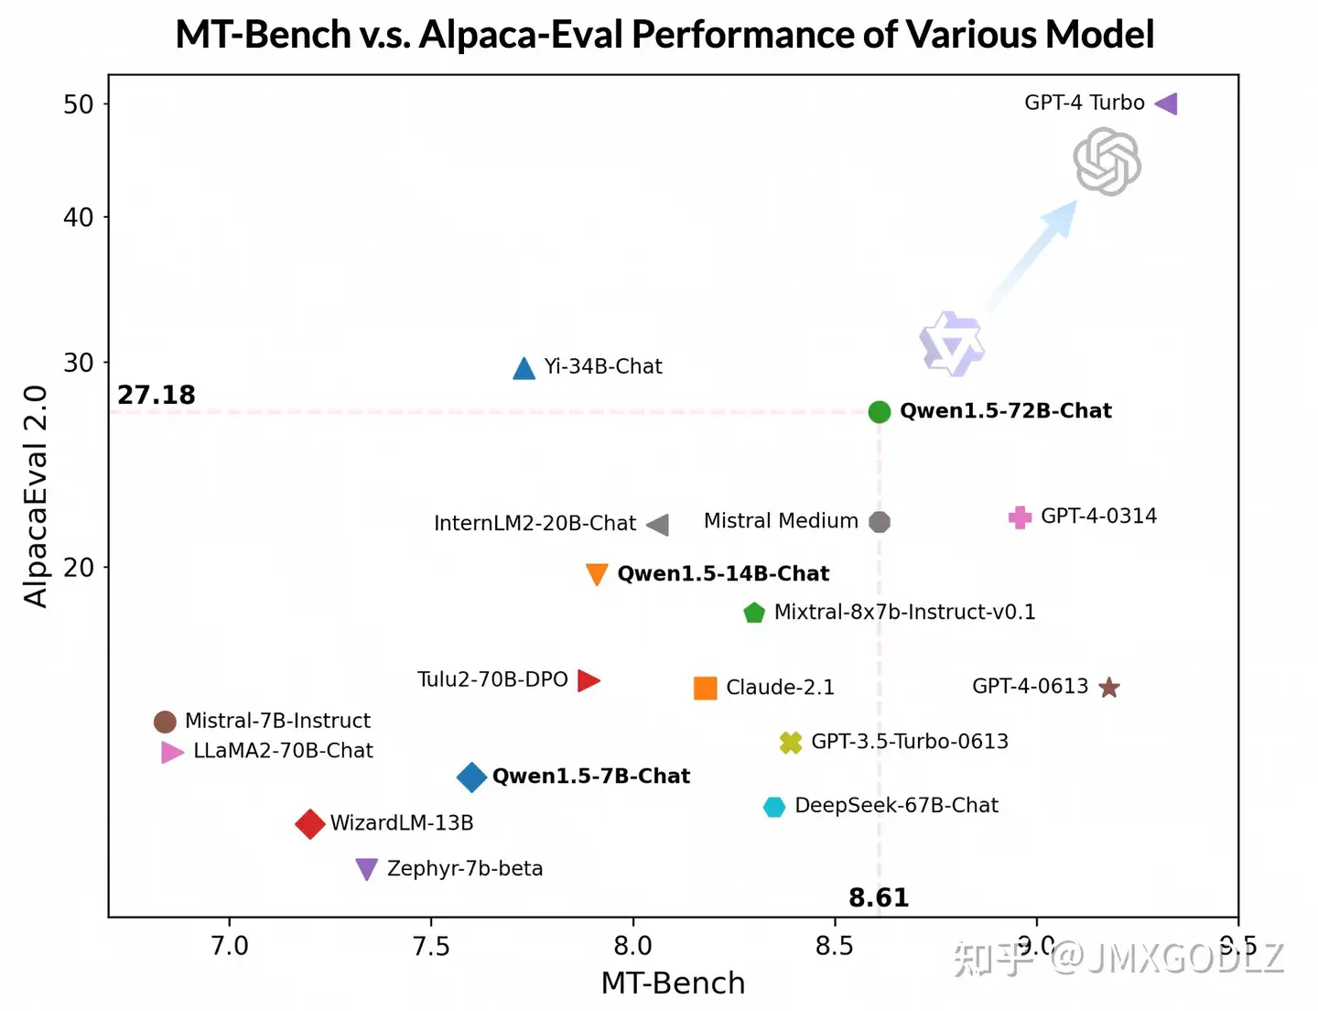
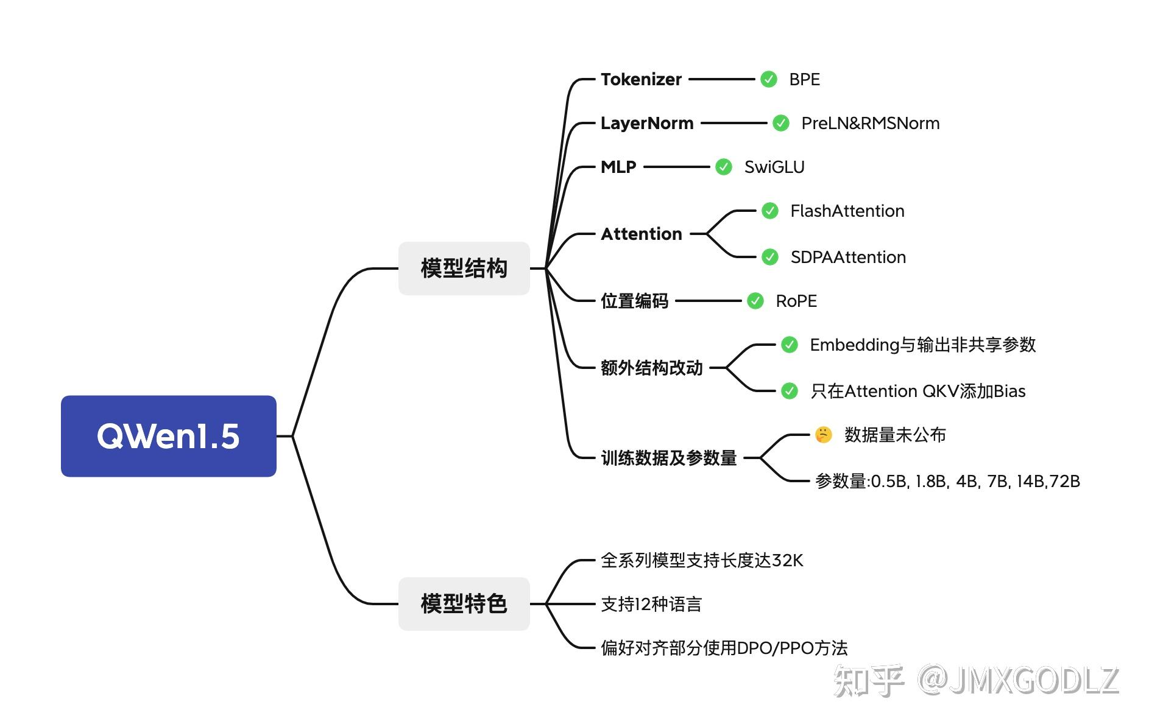
Base Model
Qwen1.5-7b-Chat

Slide 9
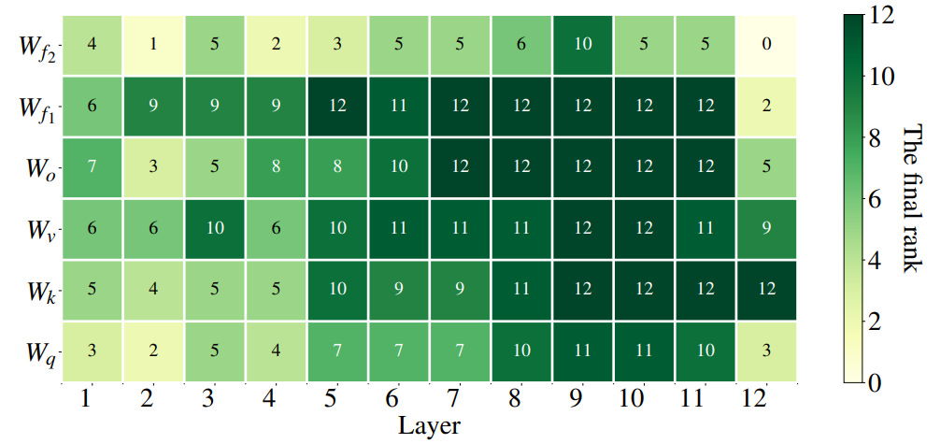
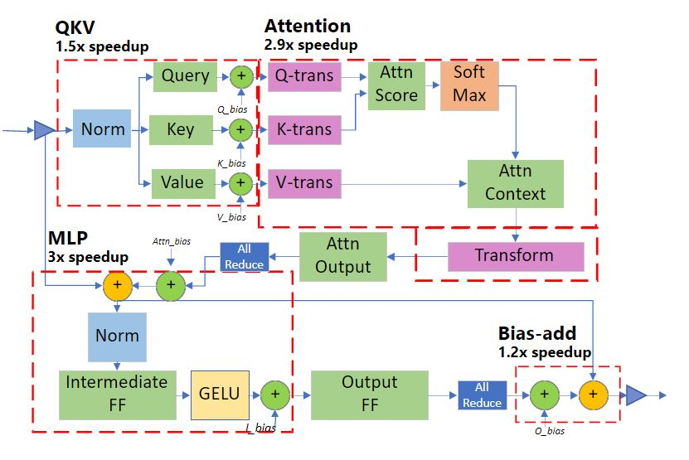
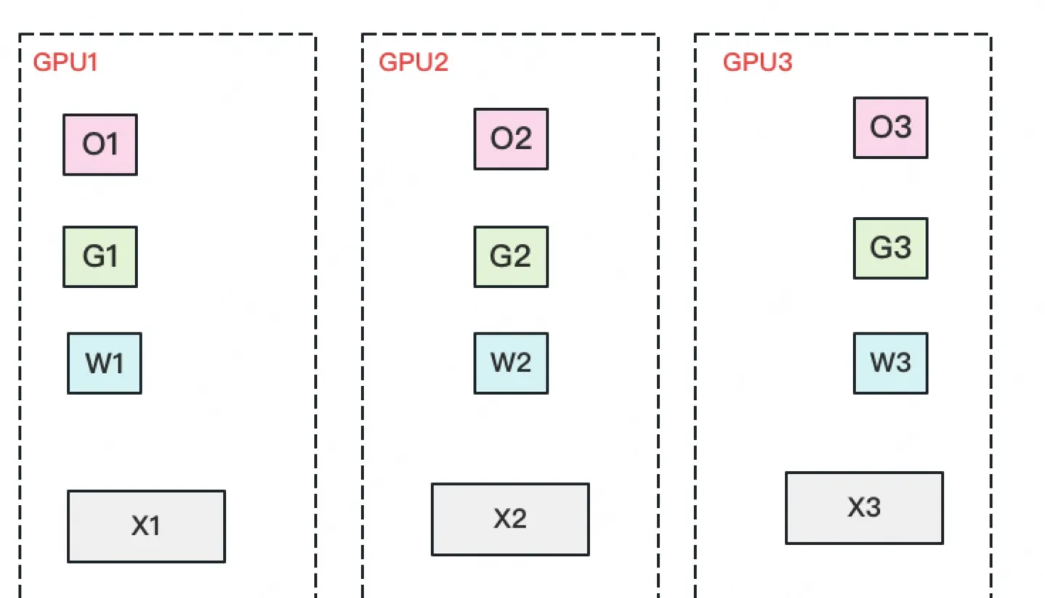
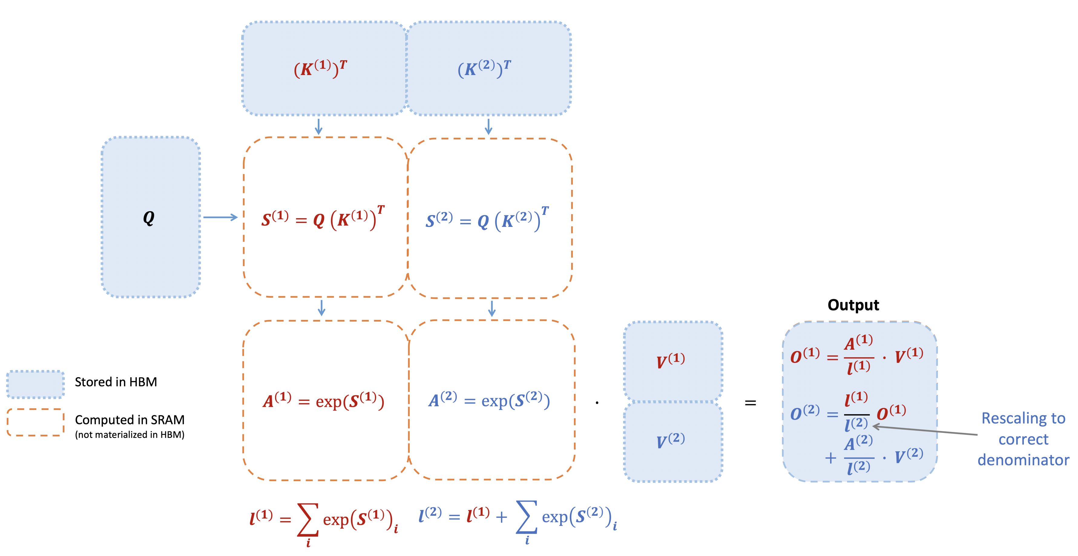
SFT
AdaLoRA
DeepSpeed(ZeRO-3)
FlashAttention-2

Slide 10

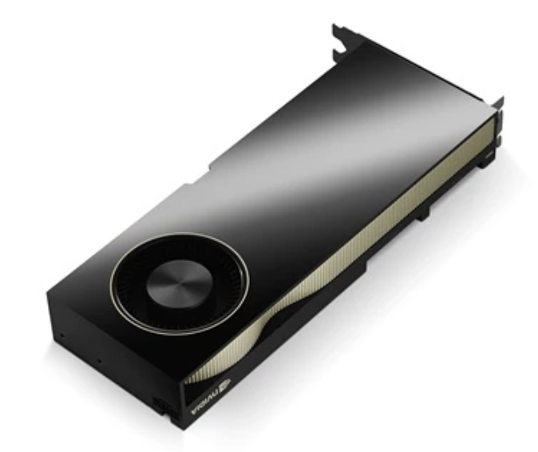
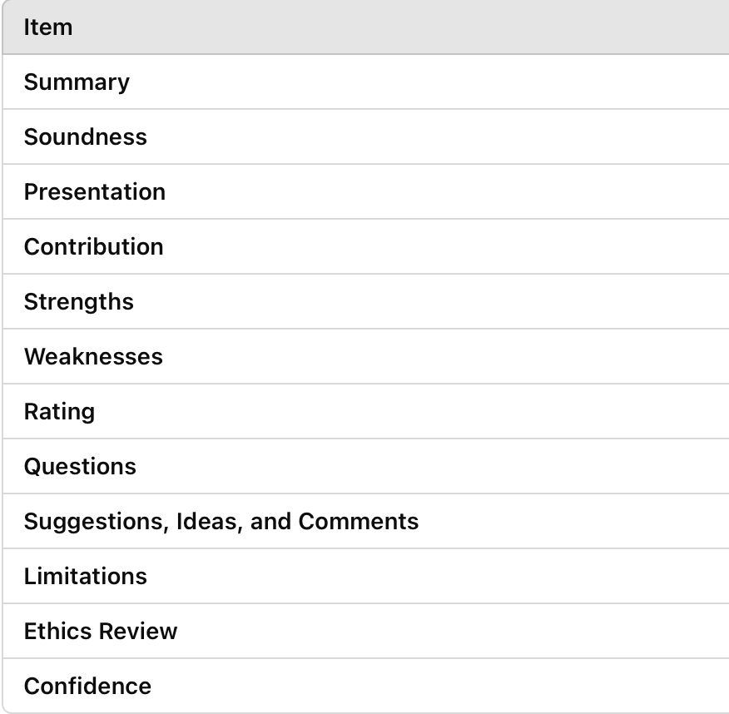
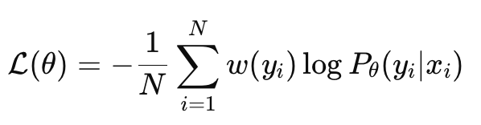
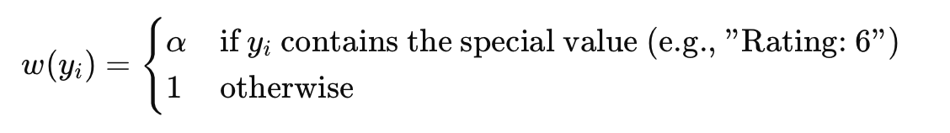
Settings
Conduct on
8*A800

Slide 11
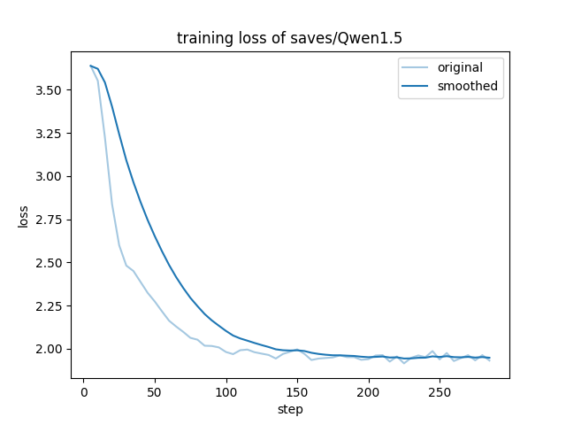
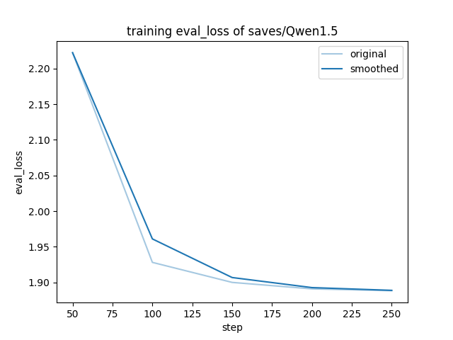
Results - Loss
Train on NIPS 2023

Slide 12
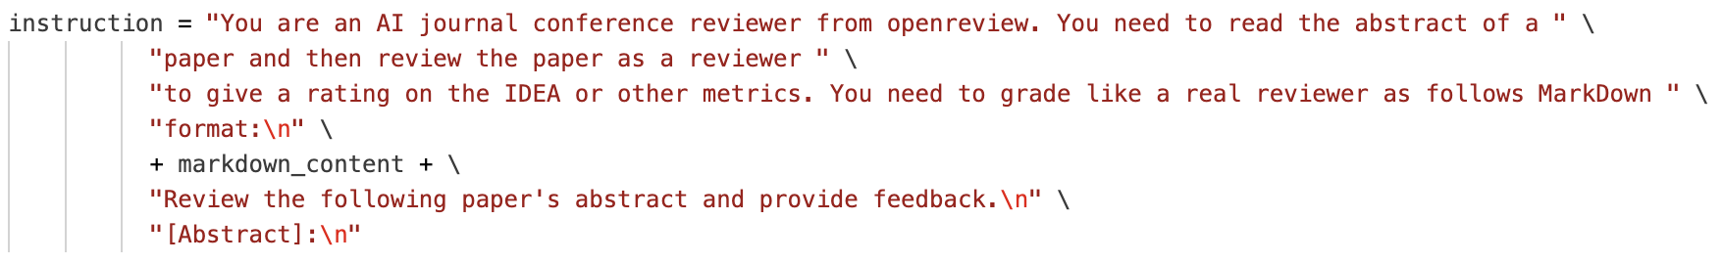
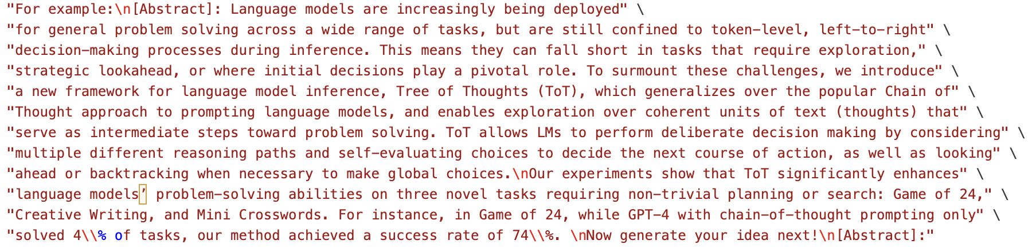
Results - Metric
Format Guide
Few shot

Slide 13
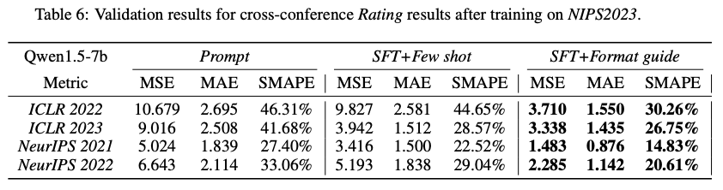
Results - Metric

Slide 14
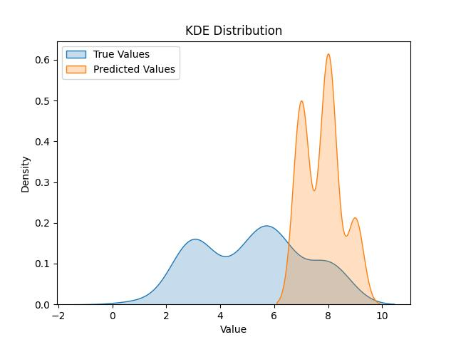
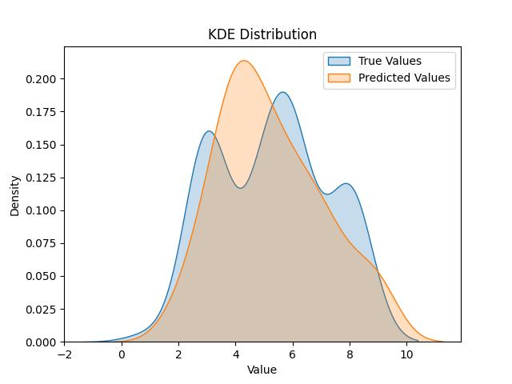
Results - ICLR2022
Prompt
SFT

Slide 15
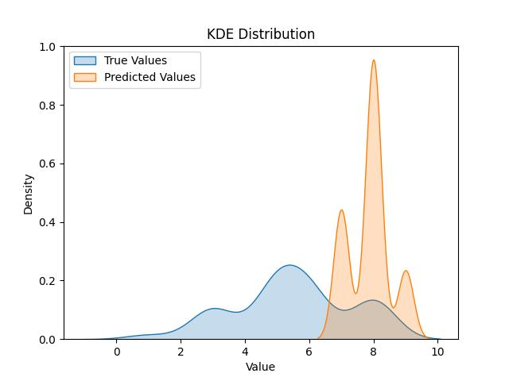
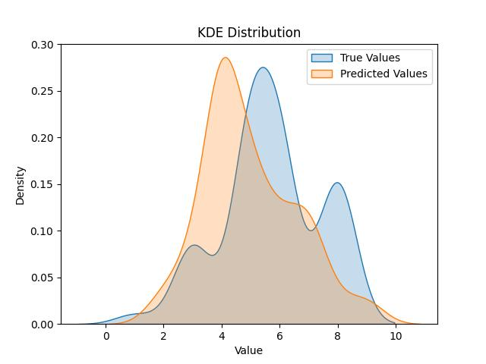
Results - ICLR2023
Prompt
SFT

Slide 16
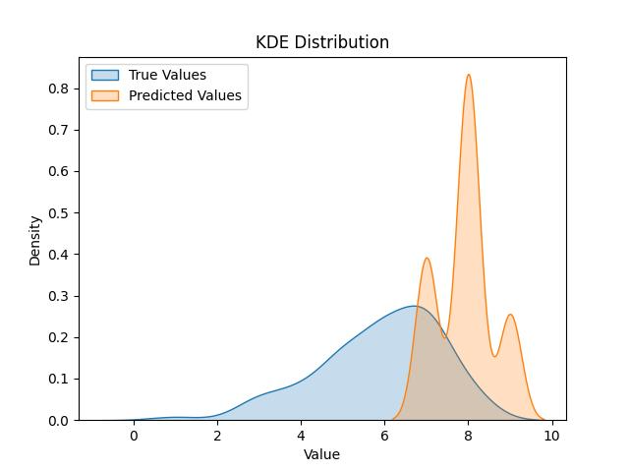
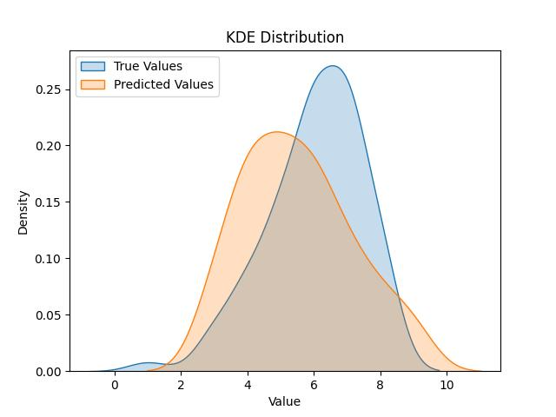
Results - NIPS2022
Prompt
SFT

Slide 17

Idea King
As reward model
💡
💡
😀
🧐
King
Critic
👎/👍
RLHF for Idea propose

Slide 18
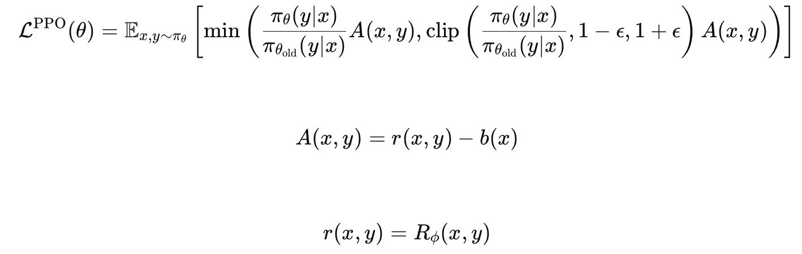
RLHF - Formula
From critic's Rating(0-10)

Slide 19
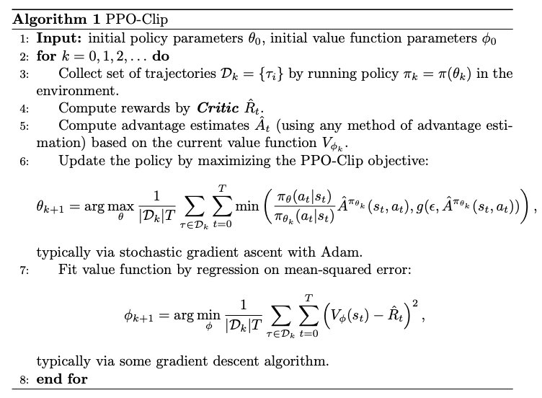
RLHF - Algorithm

Slide 20
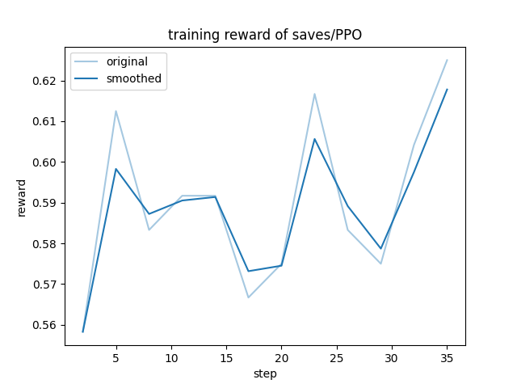
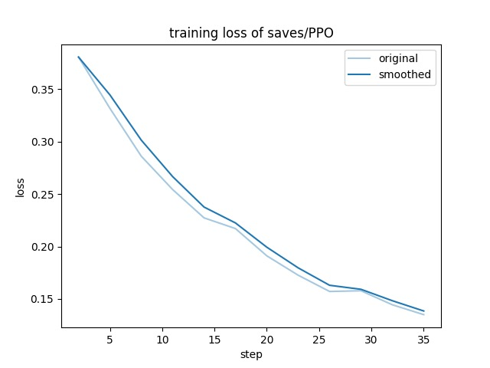
Results - Loss

Slide 21
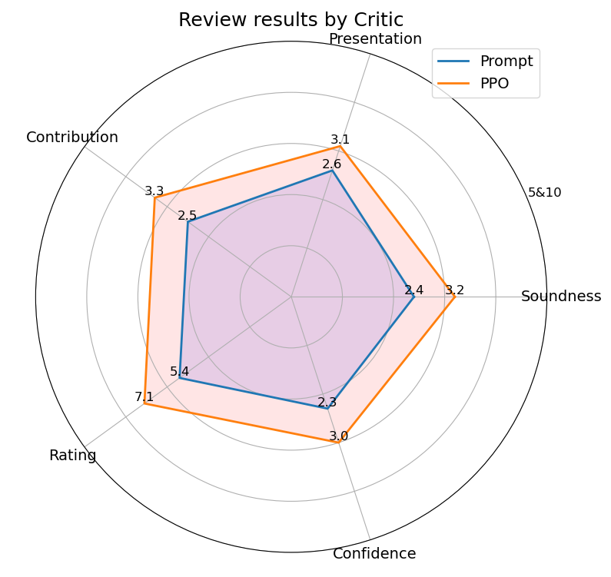
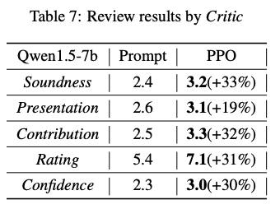
Results - Metric

Slide 22
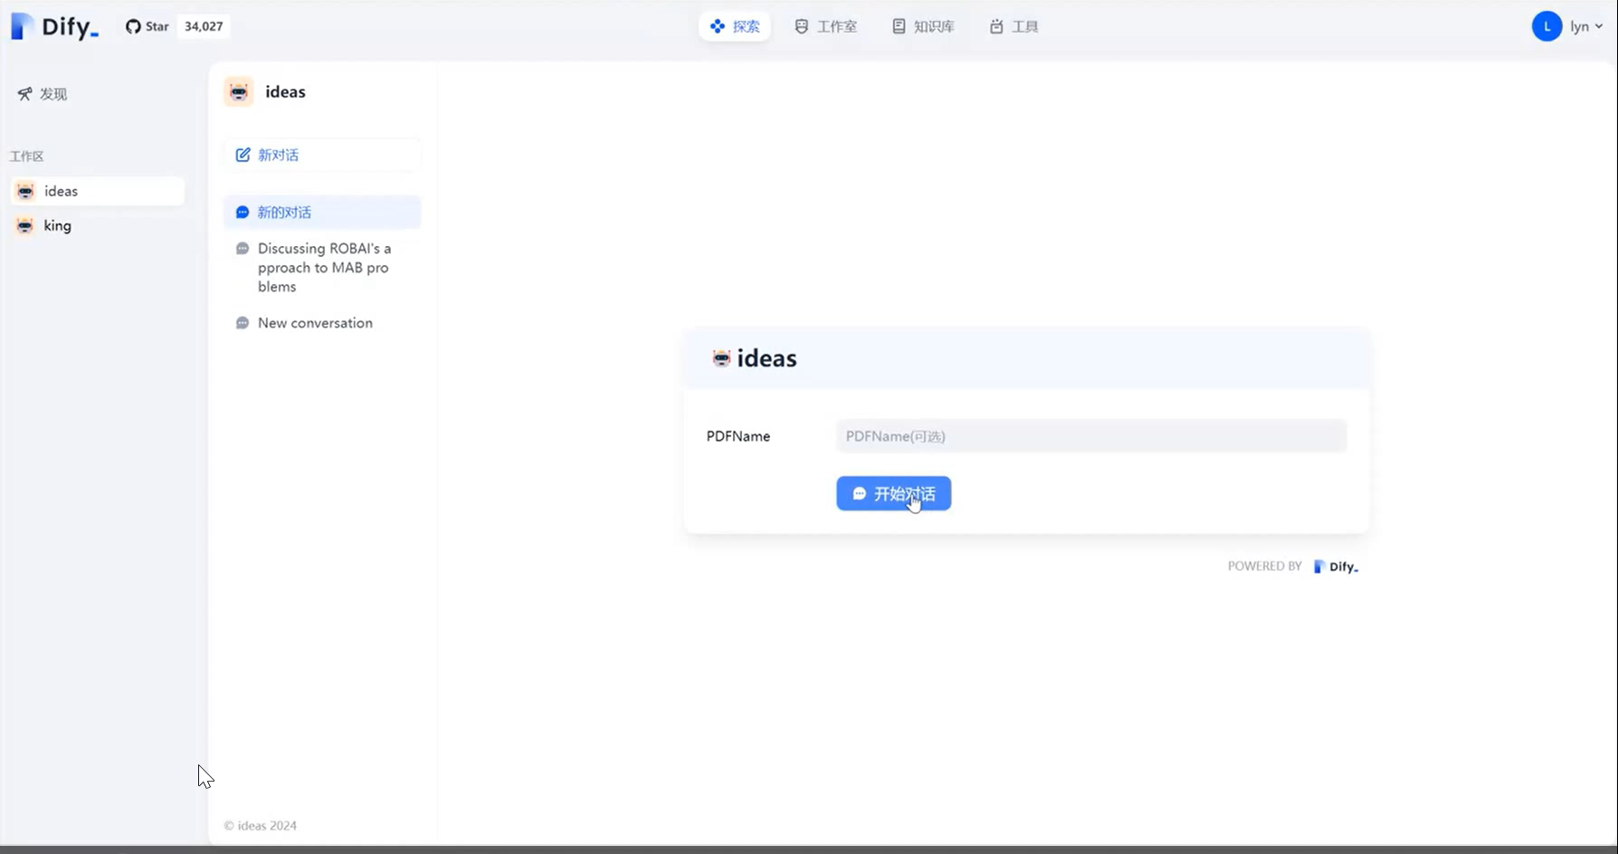
Product - DIFY Critic
Use Pipelins and Critic Models

Slide 23
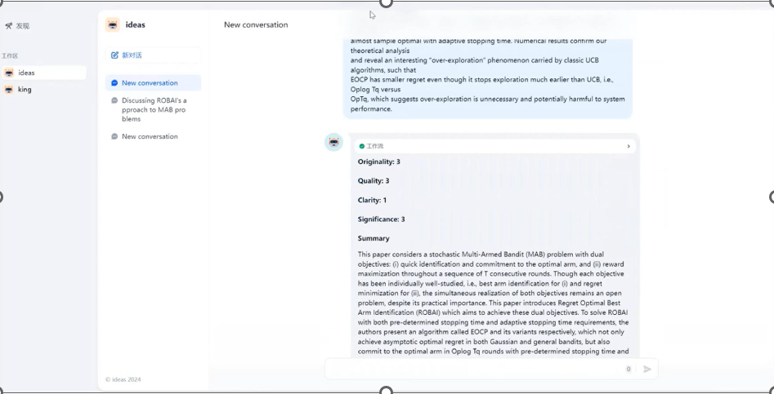
Product - DIFY Critic
Model
Select
Scores
Comments
Input Field

Slide 24
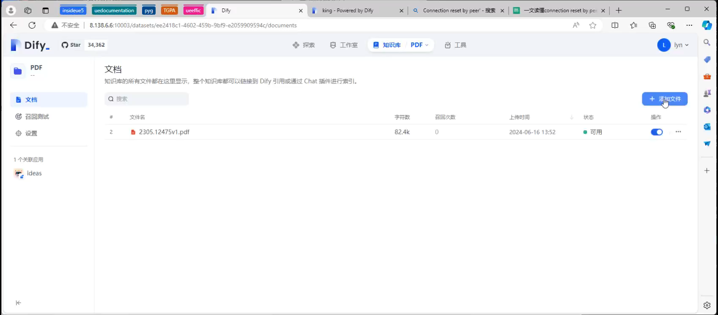
Product - DIFY Critic
Upload ANY type of papers as knowledge base

Slide 25
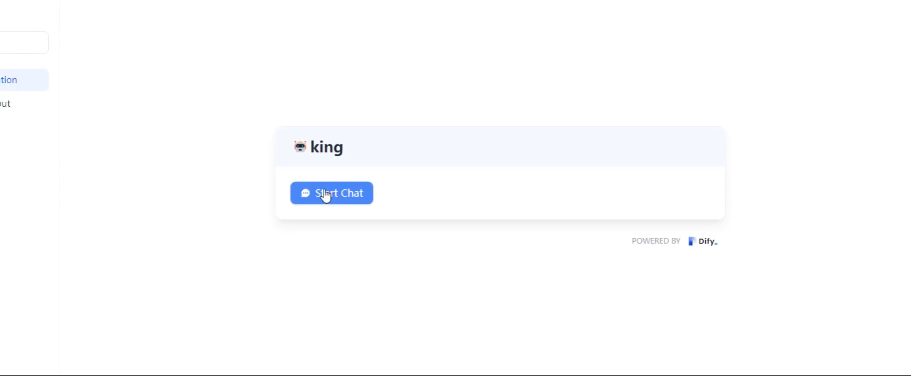
Product - Idea King
Generate Fantasy Ideas

Slide 26
Product - Idea King
ALL DEMO IN
http://8.138.6.6:10003/
Account: lyn@123.com
Password: qwer123456

Slide 27
Schedule
Week | Task
12 | Dataset Building
13 | Web Product Design
14 | Model Training
15 | Refine and test
16 | RLHF Feedback modifies
17 | Final

Slide 28

Funding
8*A800
+
An estimated budget of 500 CNY has been allocated for data acquisition costs. This budget covers the expenses related to internet data traffic, which is essential for accessing and downloading the large-scale datasets required for our research.
Funder: Prof. Huaiguang Jiang

Slide 29
Credit
Name | Jobs
Xinjie Shen | Group Leader, Project design
Guanlin Chen | Dataset Processing
Fanpu Cao | Fine Tuning, RLHF
Yang Wu | Product Web Design, Server

Slide 30
Thank you &
Q&A

