Slide 1
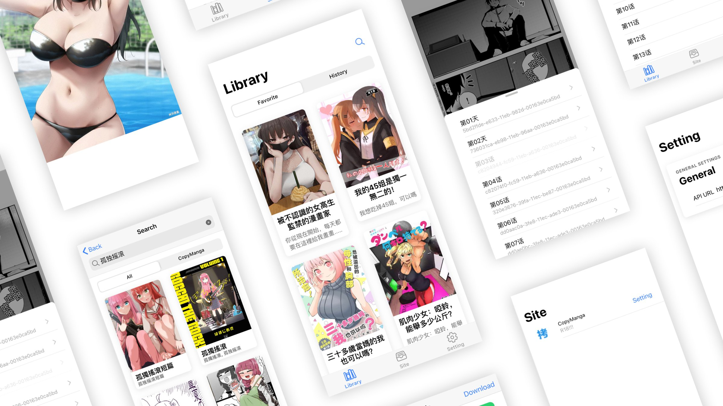
Byreader
Convenient, Consistent, Customized

Slide 2
Background
Platforms Isolation
Inconsistent
Reading Habits
Lack of
customized source of notifications
User of Manga Reader Platform
~320million
···
Managing multiple Manga Reader Platforms
Notes:
User of Manga Reader Platform: ~320million
Those target users normally managing multiple Manga Reader Platforms
Problems:
Platforms Isolation
Reading Habits
Lack of customized source of notifications
Solution: Byreader is a manga reader for those issues

Slide 3
Problems
Need extra cost to find comics
Platforms Isolation
Diversified comics are difficult to read on
a single platform
due to platform or copyright restrictions
The platform
forbids web-side reading
···
Notes:
Platform Isolation
Diversified comics are difficult to read on a single platform due to platform or copyright restrictions
The platform forbids web-side reading
Need extra cost to find comics

Slide 4
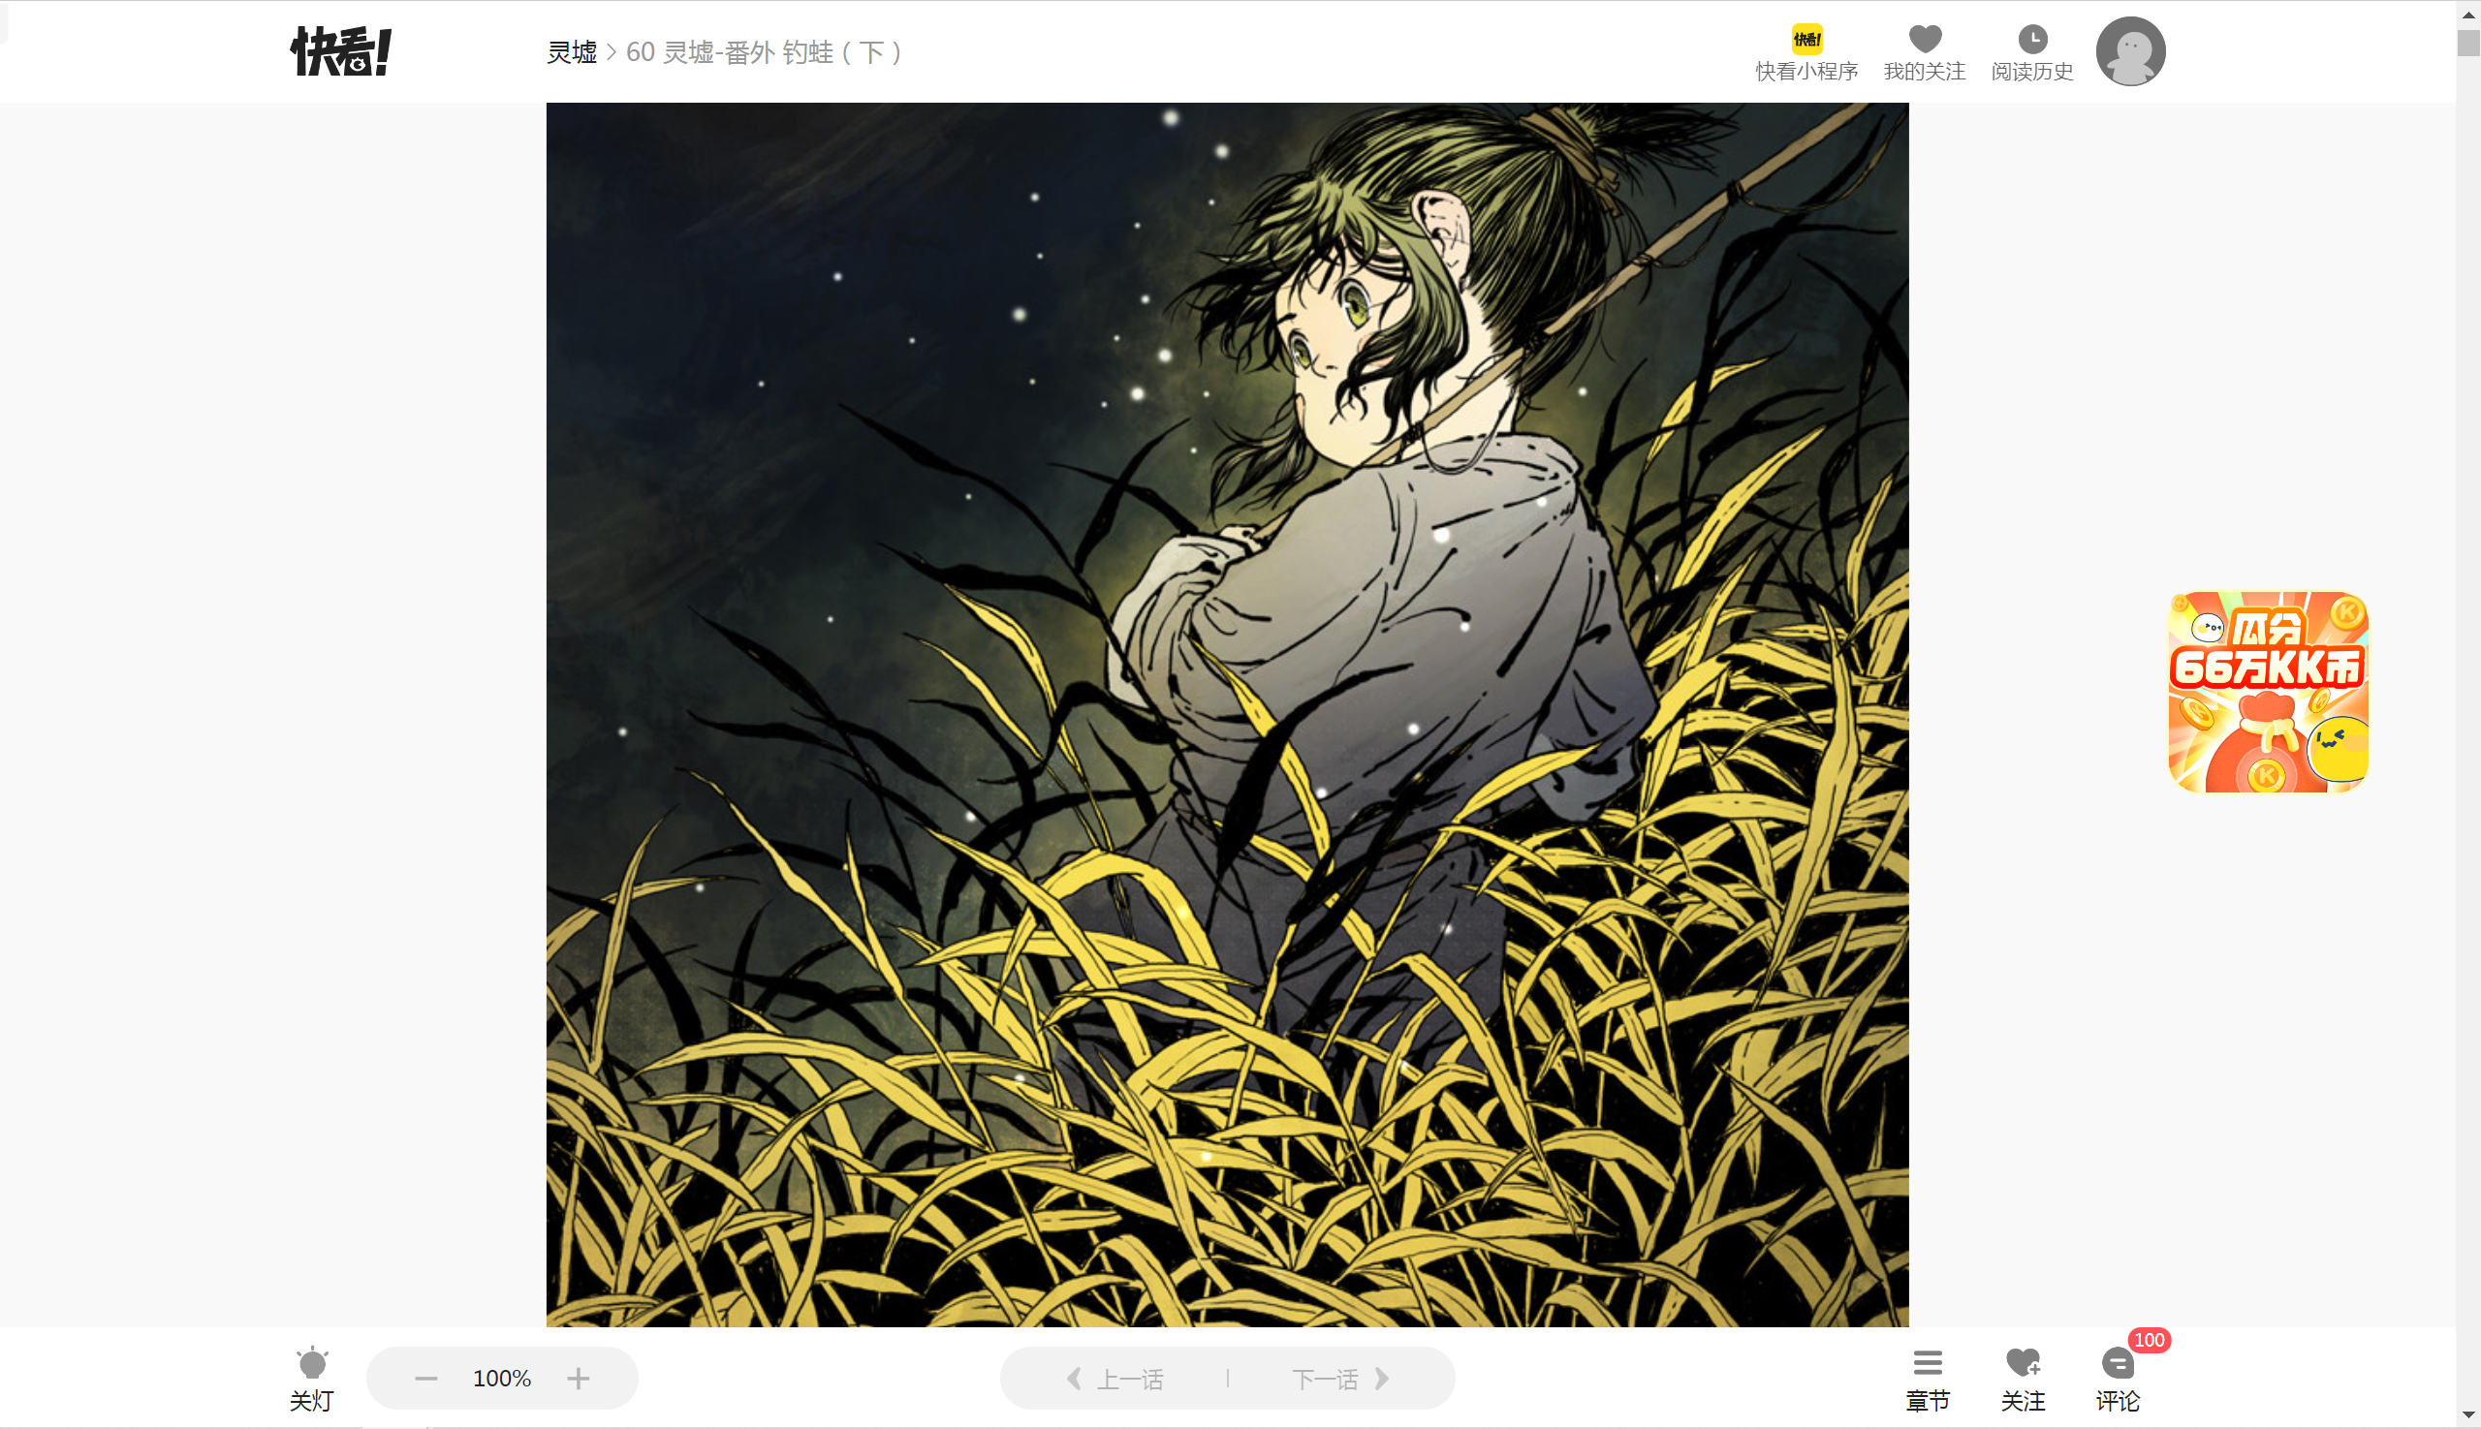
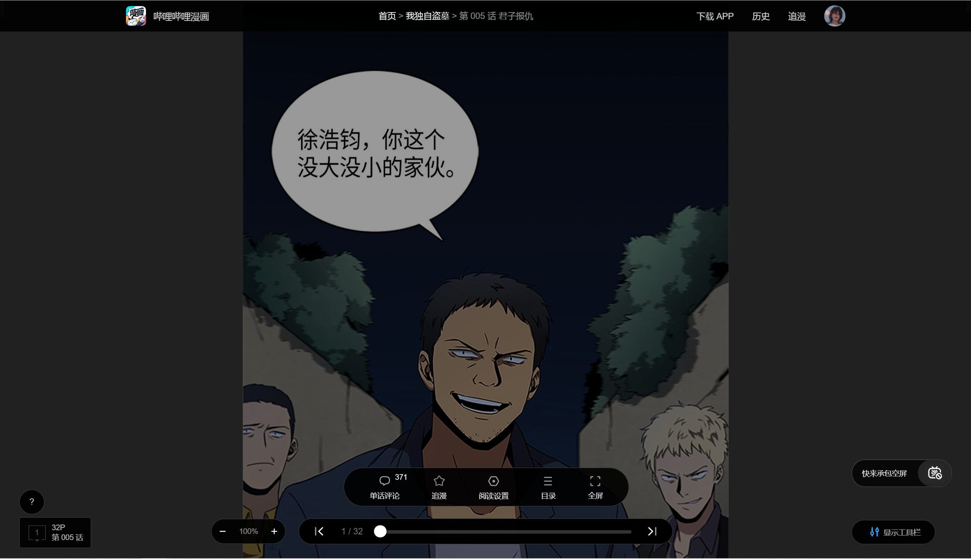
Problems
Need extra cost to Read comics
Inconsistent
Reading Habits
Different interface settings for different
···
Notes:
Reading Habits
Different interface settings for different
Web side vs platform side
difficult to unify

Slide 5
Solutions
Cross-platforms
Byreader
Consistent
Reading experience
One user, one account
Everywhere, Every manga
All customized notifications
Notes:
User of Manga Reader Platform: ~320million
Those target users normally managing multiple Manga Reader Platforms
Problems:
Platforms Isolation
Reading Habits
Lack of customized source of notifications
Solution: Byreader is a manga reader for those issues

Slide 6
Byreader
Frontend
ReaderView
Horizontal
SearchView
Vertical
HomeView
LibraryView
ComicView
RESTful API
Backend
Ingress
User
File
Site
Group
Cache
CopyManga
Fetcher
Bilibili

Slide 7
Possible concerns
Why Cross-Platform?
Illegal Issues?
Every time Everywhere
Consistent user experience
Only comic deserve your time
Third-party Viewer,
No local or server storage,
No offense to
information transmission rights
Notes:
Image generation: txt2img,img2img, augmentation, high quality
Molecule generataion

Slide 8
Target User & Growth
User of Online Manga Platform in China:
Estimating 320 million in 2023
Target User
Age: below 40
Occupation: Students & workers
Mananging multiple Manga Readers at once
ACGN User in China:
460 million in 2021, CAGR = 12.9%
460 million * (1 + 12.9%)^2
= 590 million in 2023
Notes:
Image generation: txt2img,img2img, augmentation, high quality
Molecule generataion

Slide 9
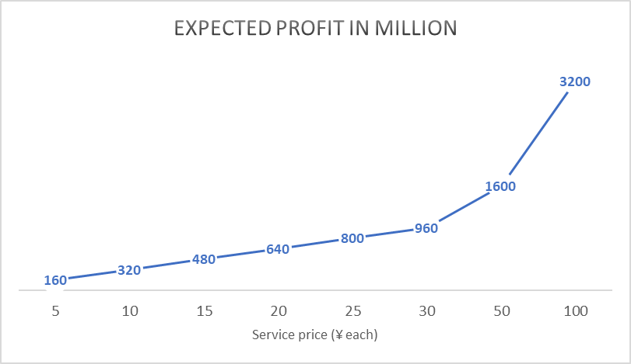
Market Size
Traget User = 320 million
Assuming 10% of them would use our service
Profit = 320 * 10% * Service Price

Slide 10
Credit
Member | Tasks
Lau Yuet Hei | Marketing investigating
Shen Xinjie | Main proposal design; Product manager
Chen Guanlin | Solution implementation

Slide 11
Thank you
Q&A

